Slide 1
Phone Meets Web
OWASP DC
November, 2016
Patrick McNeil
patrick@themcneils.org / pmcneil@Veracode.com
@unregistered436

Slide 2
What’s this about?
Notes:
Due to increased VoIP adoption over the last few years, however, telephony attacks are provocative once again and we’ve seen VoIP related talks at Black Hat and DEF CON. Most manufacturers have heard the demand for APIs and web interfaces and embedded them in PBX(es) and phones – of course not always in a secure fashion. So, tonight we’re going to talk about the intersection of “the web” and modern voice over IP systems. I’ll apply some of the OWASP Top 10 to the common vulnerabilities and briefly discuss some of the things one can do with a compromised VoIP system beyond just making free phone calls.

Slide 3
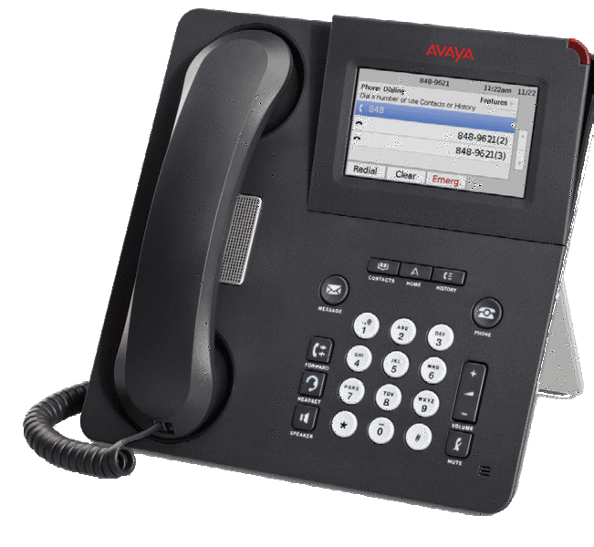
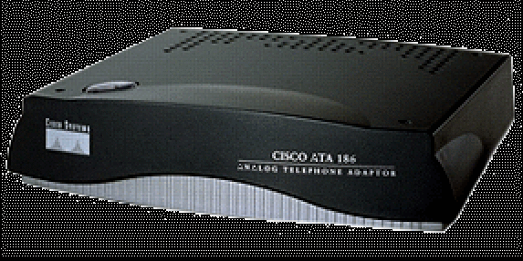
The move to IP based PBX
Cash savings, mobility, and features!
Internet enables
“Trunking” to choice of provider from local PBX (Asterisk / FreePBX / Trixbox, Cisco, Avaya, Lync/Skype, etc)
Cloud PBX services
SIP enabled “hard phones”, soft clients, Integrated Access Devices (IAD), & Analog Telephone Adapters (ATA)
Have to connect … and not everyone does it right

Slide 4
Fraud schemes
Why do we care?
Notes:
Let’s assume for a moment that you have compromised a PBX and you can make phone calls. Here are just two of the more popular fraud schemes that are possible once you “own” a PBX.

Slide 5
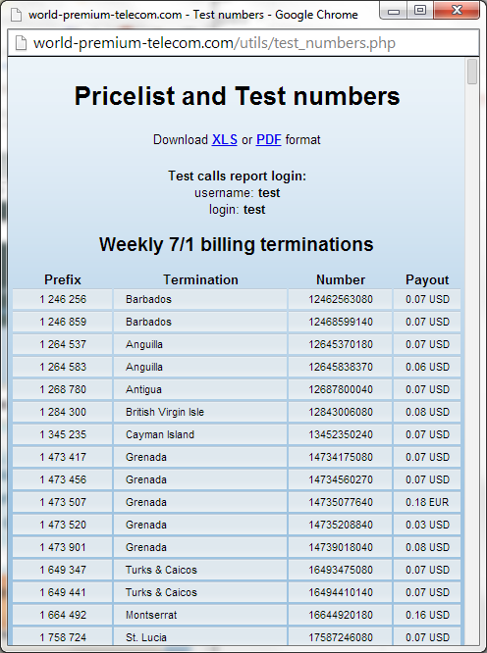
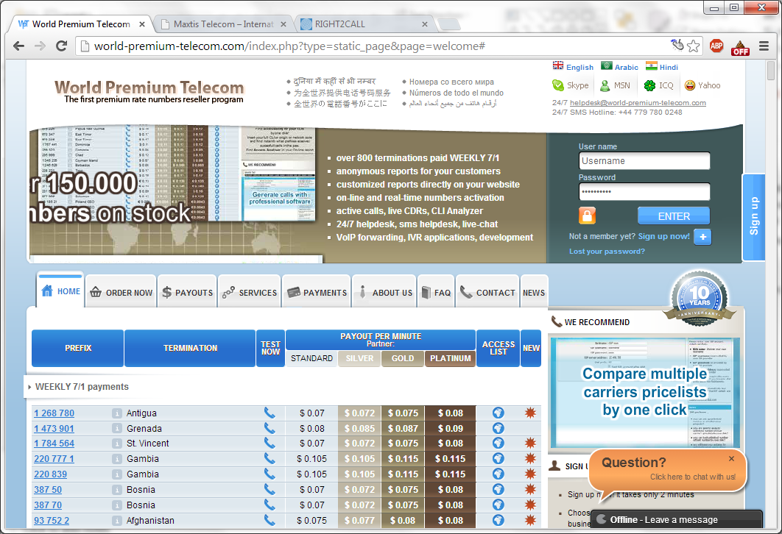
International Revenue Sharing Fraud
Register a Premium Rate Service number in another country, including IVR services that can answer calls.
Notes:
You get a number to drive calls to and a share of profit per minute
Note the test number. This is one of the first ones you’ll see going out your network

Slide 6
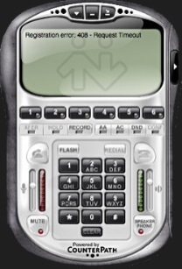


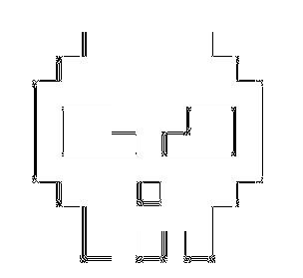
International Revenue Sharing Fraud
Using a cracked PBX extension, makes a test call with a soft client or soft client API to make sure calls will complete…
Generate calls using Asterisk script, SIPp, sipcli, soft client API, etc
Get paid by the PRS provider once a week
Use the PBX for a weekend and moves on to a new one
Internet
PSTN
PRS Provider IVR

Slide 7
Wholesale Fraud / Toll Bypass
Sell access to cracked PBXes to someone else to carry international minutes between carriers. You give them a user/pass for SIP registration.
Most of the money, and none of the headache of driving traffic (or of getting backtracked)
Internet
Corporate IP Network
PSTN
New SIP Trunk
SIP Trunk
IVR
Notes:
Call routing sold on exchange where players remain anonymous
http://www.billingworld.com/articles/2000/09/bandwidth-and-minutes-exchange-rating-billing-and.aspx
Fraudster uses compromised system to forward traffic between two valid service providers for attractive rates, usually advertised on wholesale marketplace websites
Revenue paid to fraudster by operators who route calls to the fraudulent trunk; Paid daily or weekly, valid subscriber billed monthly
Wholesale providers provide transit capabilities to other operators and networks
▪So these organizations have no consumer customers only provide services to other carriers
–This mean that normal service providers do not need to have interconnection points with every destination around the world
▪The wholesale networks provide the backbone for international calling services
▪The wholesale carrier can only see transit traffic; Typically, no local traffic of carriers, no customer details, partial call data records are available to them

Slide 8
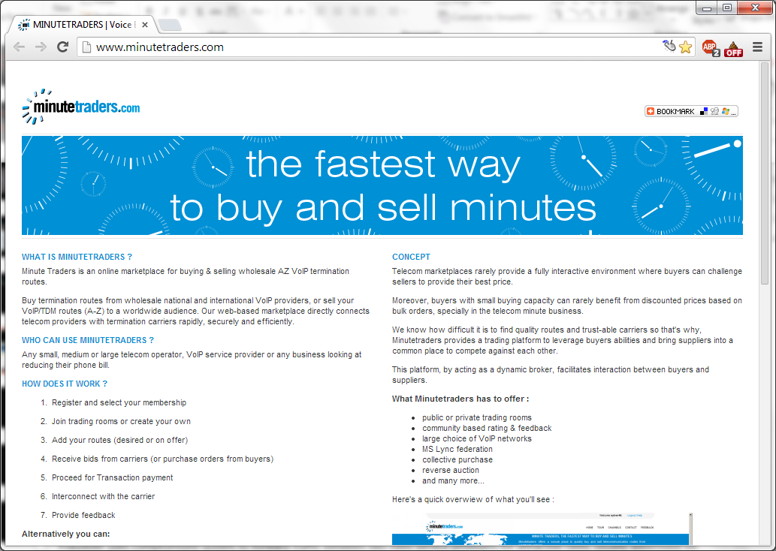
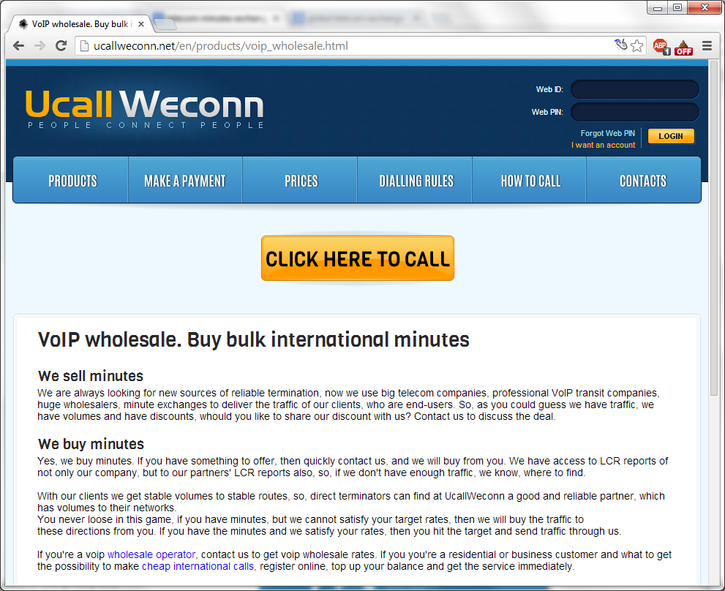
Wholesale Fraud / Toll Bypass
A few Google searches and you can find services to sell minutes to. These may or may not be legit, and may or may not catch you if they are.
Notes:
Wholesale providers provide transit capabilities to other operators and networks
So these organizations have no consumer customers only provide services to other carriers
This mean that normal service providers do not need to have interconnection points with every destination around the world
The wholesale networks provide the backbone for international calling services
The wholesale carrier can only see transit traffic; Typically, no local traffic of carriers, no customer details, partial call data records are available to them
You charge a rate that undercuts the regular SIP trunking providers because you don’t have to pay tariffs or the in-country charges for the trunks that connect to the phone network.
http://www.billingworld.com/articles/2000/09/bandwidth-and-minutes-exchange-rating-billing-and.aspx
Fraudster uses compromised system to forward traffic between two valid service providers for attractive rates, usually advertised on wholesale marketplace websites
Revenue paid to fraudster by operators who route calls to the fraudulent trunk; Paid daily or weekly, valid subscriber billed monthly

Slide 9

Finding targets
Now this is what I call a Target Rich Environment!

Slide 10
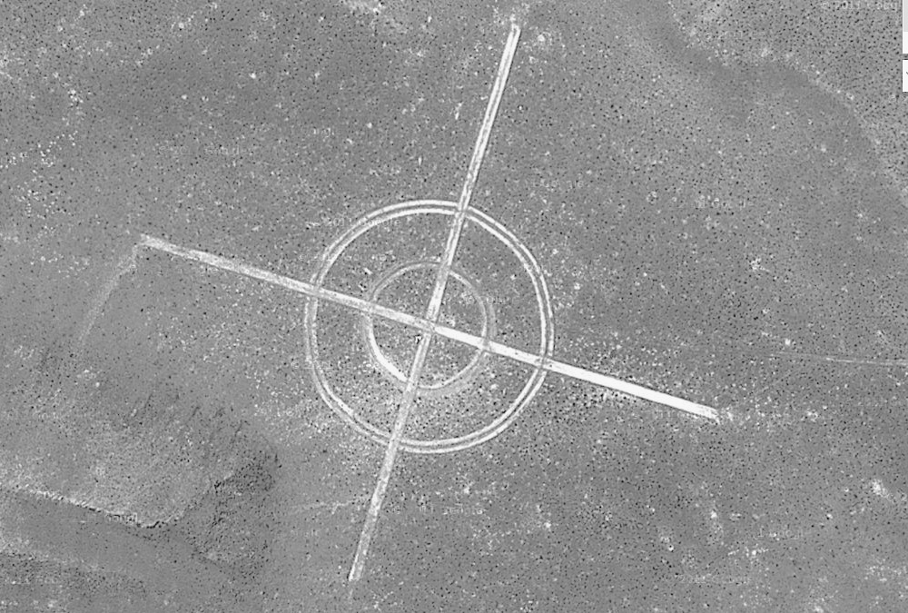
Rapid7 UDP Scans (scans.io) Comparing an Oct 2016 scan to Jul 2015 Elasticsearch/Kibana
Asterisk User-Agents
11MM SIP entries in dataset, down 4 MM entries
26,000 containing “Asterisk” (half of 2015 scan)
23,414 are just “Asterisk PBX”
(top server UA in the list, more than doubled count since 2015)
346 "Asterisk PBX 1.6.0.26-FONCORE-r78“ – TrixBox – dropped threefold! (This is good, and you’ll see why shortly)
Findings that are still true:
Insecure phones & MTAs
Old SMB systems from Cisco, Nortel, Avaya, etc.
Unexpected Finds from 2015 still true:
2033 hits on “camera”, 1883 in CN
Top user-agent - 3.15MM “FRITZ!OS” MTAs deployed in Germany, Switzerland, Netherlands, etc
LOTS of Huawei in Iran, footprint grown 15X since 2015
Notes:
As an exercise I took the Rapid7 Internet Wide Scan Data results for SIP UDP and did some quick analysis using ElasticSearch and Kibana visualization back in 2015 in preparation for my DEF CON talk. The SIP scan included a single OPTIONS request to port 5060 at each address, which may be blocked by administrators. Here are some of the numbers
Fritz OS MTAs in Deutsch Telecom,Telefonica, and Vodaphone IP ranges primarily
There are many devices protected by ACLs, SBCs, and other security mechanisms that won’t show up in the scan
https://scans.io/study/sonar.udp
http://en.avm.de/products/fritzbox/fritzbox-7490/
http://routersecurity.org/bugs.php
http://www.weirdgoogleearth.com/wp-content/uploads/2013/11/crosshair-bomb-target.jpg

Slide 11
Censys.io – scans.io search engine
Allowed for port 80/443 searches not done before with my Elasticsearch / Kibana research
Searched for HTTP titles and certificate common names with distro names in them – no guarantee, but a great lead
80.http.get.title: <name>
FreePBX | 11,687
Elastix | 4497
Asterisk | 386
TrixBox | 164
43.https.tls.certificate.parsed.issuer.common_name
FreePBX | 149
Elastix | 13
Asterisk | 112
TrixBox | -
Notes:
https://www.censys.io/ipv4?q=443.https.tls.certificate.parsed.issuer.common_name%3A+freePBX
Ex: http://202.78.218.101/user/index.php?home

Slide 12

Asterisk
Asterisk Created in 1999
Now developed by Digium under GPL
14.0.2 Latest Stable, 13.11.2 LTS
Lots of variants, some SW only, some including HW
FreePBX
Asterisk@Home
TrixBox
PBX In a Flash
Elastix
AskoziaPBX
Asterisk for Raspberry Pi

Slide 13
Protocols
Management
SNMP
HTTP
CLI
API
Asterisk Management Interface (AMI) – default port 5038
Asterisk Gateway Interface (AGI)
Asterisk REST Interface (ARI) – default port 8088
Services
SIP / RTP – voice, video, IM
AIX – not commonly used anymore
WebRTC
Notes:
AMI provides a mechanism to control where channels execute in the dialplan. Unlike AGI, AMI is an asynchronous, event driven interface. For the most part, AMI does not provide mechanisms to control channel execution - rather, it provides information about the state of the channels and controls about where the channels are executing.
AGI is analogous to CGI in Apache. AGI provides an interface between the Asterisk dialplan and an external program that wants to manipulate a channel in the dialplan. In general, the interface is synchronous - actions taken on a channel from an AGI block and do not return until the action is completed
And so, before Asterisk 12, if you wanted your own custom communication application, you could:
Write an Asterisk module in C, or
Write a custom application using both AGI and AMI, performing some herculean effort to marry the two APIs together (as well as some dialplan trickery)
http://www.voip-info.org/wiki/view/Asterisk+manager+API
http://www.voip-info.org/wiki/view/Asterisk+AGI
https://wiki.asterisk.org/wiki/pages/viewpage.action?pageId=29395573

Slide 14
Asterisk REST Interface
ARI is an asynchronous API that allows developers to build communications applications by exposing the raw primitive objects in Asterisk - channels, bridges, endpoints, media, etc. - through an intuitive REST interface. The state of the objects being controlled by the user are conveyed via JSON events over a WebSocket.
AMI
ARI
AGI
Call Control
Dialplan Execution
Custom Communication Application

Slide 15
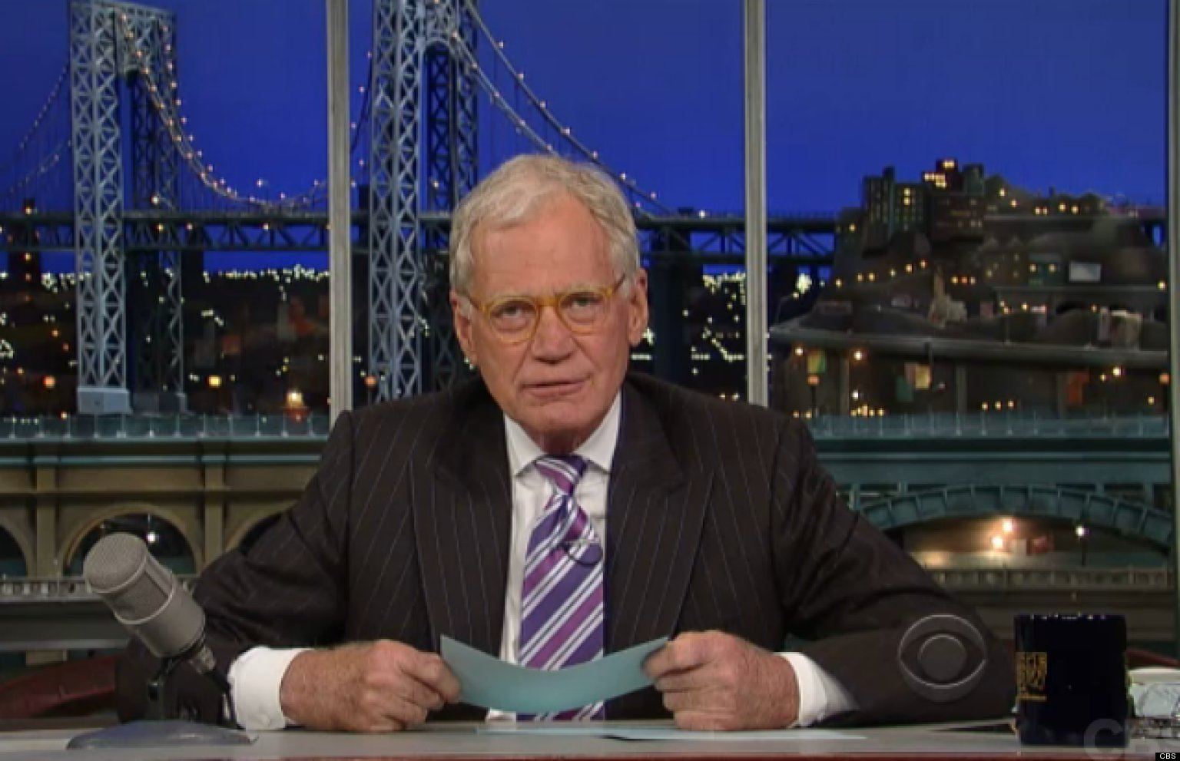
Tonight’s top ten Casting the OWASP Top Ten to Common VOIP SYStems

Slide 16
OWASP Top 10 Vulnerabilities
Types of Issues Common to Asterisk / VoIP PBX
A1: Injection
A2: Broken Authentication and Session Management
A3: Cross-site Scripting
A4: Insecure Direct Object References
A5: Security Misconfiguration
A6: Sensitive Data Exposure
A9: Using Components with Known Vulnerabilities
A10: Unvalidated Redirects and Forwards
Other Notable Issues / Non-OWASP Top 10
Insufficient Anti-automation
Denial of Service (exhaustion, crashes)
Identity Issues

Slide 17
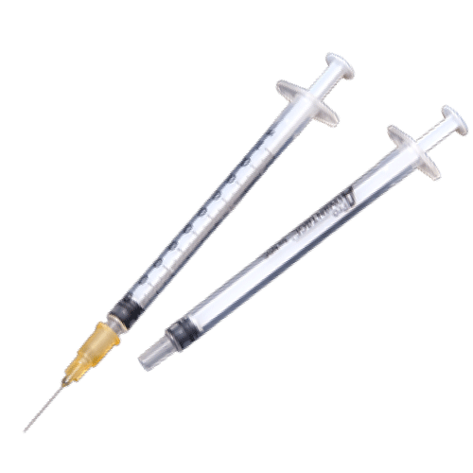
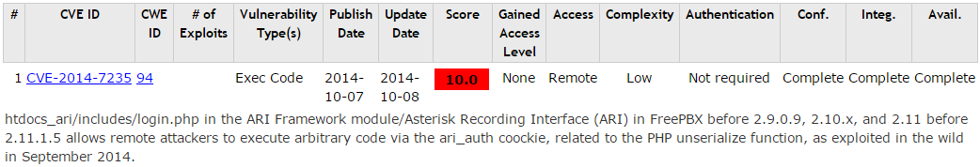
A1: Injection
Web Interfaces
API Interfaces
Bonus
SIP Injection
SQL injection / XSS via SIP headers
Modification of the signaling stream possible if MITM – insert other parties in call, insert headers for billing fraud, caller spoofing, etc.
Voice / Media Injection – modification of the RTP stream – possible but a bit more challenging
Log Contamination – management injection possible if SIP messages copied to the logs (demo later!)
Notes:
Your standard SQLi is of course present in various web interfaces, most usually parameters that aren’t sanitized
However what people hadn’t considered was the fact that dial plan information is sometimes looked up in a database, so SIP URL information from source or destination number could be used to execute SQL commands if not sanitized. (CVE-2007-5488 in Asterisk)

Slide 18

A2: Broken Authentication and Session Management
REGISTER sip:192.168.1.123 SIP/2.0
Via: SIP/2.0/UDP 192.168.1.1:8166;branch=z9hG4bK-d8754z-0be76a4b680f6408-1---d8754z-;rport
Max-Forwards: 70
Contact: <sip:1000@192.168.1.1:8166;rinstance=c7c558226c47c266>
To: <sip:1000@192.168.1.123>
From: <sip:1000@192.168.1.123>;tag=309f3210
Call-ID: YWM4NWQxNThiNGEwMjhmYTJhZmIwYzJiNjMxNTY1MjE
CSeq: 2 REGISTER
Expires: 3600
Allow: INVITE, ACK, CANCEL, OPTIONS, BYE, REFER, NOTIFY, MESSAGE, SUBSCRIBE, INFO
User-Agent: X-Lite 4.7.1 74247-647f3e8e-W6.1
Authorization: Digest username="1000",realm="asterisk",nonce="35e47ee9",uri="sip:192.168.1.123", response="33ac377e4d50ad6026837ef37b2d33ce",algorithm=MD5
Content-Length: 0
Notes:
SIP authentication uses a challenge response mechanism that is dated and considered insecure.
Besides signaling and call confidentiality, this is another reason why SIP and RTP can be encrypted and carried over TLS and SRTP. That’s great, but most implementers only use server authentication, and administrators don’t take the time to configure mutual authentication where both the server and endpoint authenticate each other’s certs. Certificate management is too “hard”.
Of course unless you have cracking protections like fail2ban or a VoIP security appliance then SIP credential cracking can be easy since SIP / VoIP tends to have a lack of anti-automation features
More recent versions of Asterisk may not respond or will send back the same error code for all extensions, but good research and use of an alternative SIP method in the scan usually allows a bypass.
WebRTC
Naïve implementations still vulnerable to MiTM
TLS / WSS not required
DTLS used, but with self signed certs
https://webrtchacks.com/webrtc-and-man-in-the-middle-attacks/

Slide 19
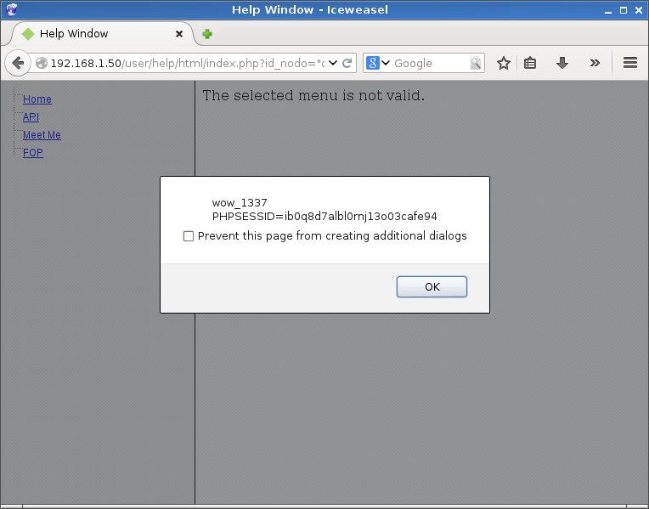
A3: Cross-site Scripting
You expected this one, right??
Unauthenticated XSS
/user/help/html/index.php?id_nodo=%22onmouseover%3dalert%28%27wow_1337\n%27%2bdocument.cookie%29%3d%22
Translation:
?id_nodo=“onmouseover=alert(‘wow_1337\n’+document.cookie)=”
http://packetstormsecurity.com/files/127522/Trixbox-XSS-LFI-SQL-Injection-Code-Execution.html - By AttackTerrorist
Notes:
Demo

Slide 20
A3 Demo
Not logged into Maint mode
See XSS on mouseover
See no PHP web shell
XSS happens
Shell there now
Test access

Slide 21
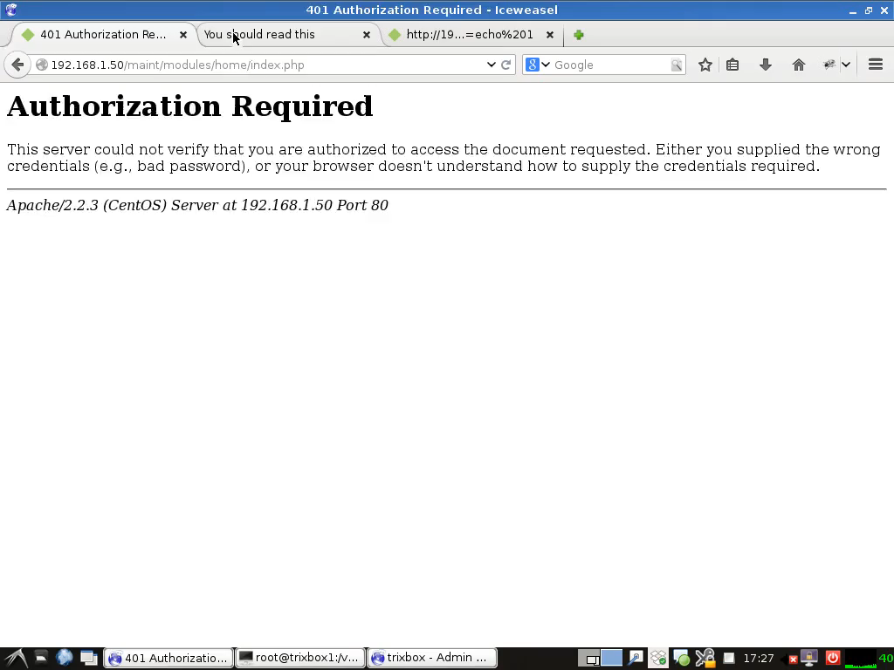
A3 Demo

Slide 22
A4: Insecure Direct Object References
Local File Inclusion not uncommon in the web interfaces. When combined with A1 – a SIP injection …

Slide 23
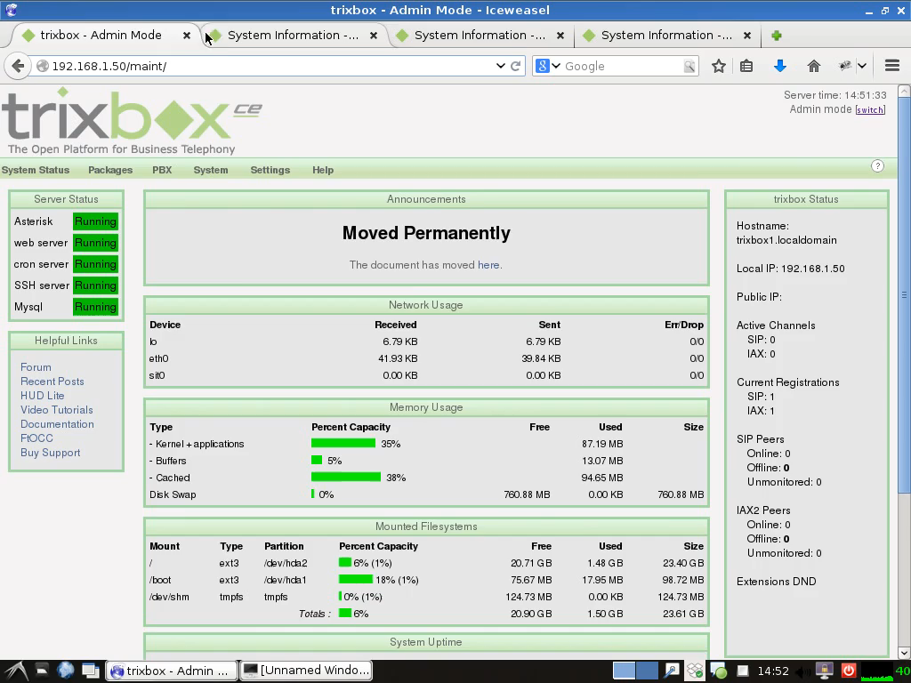
A4: Insecure Direct Object References
Local File Inclusion not uncommon in the web interfaces. When combined with A1 – a SIP injection …

Slide 24
A5: Security Misconfiguration
Internet exposed admin / API interfaces
Default passwords
SIP allowguest – Default = yes
Three or four digit extensions by default
Easily crackable SIP extension passwords
Four digit voicemail passwords
Notes:
Why is admin interface in the internet??
Default passwords – there are versions of FreePBX that have an admin password that is not settable via the GUI, but grants GUI access!
http://www.voip-info.org/wiki/view/Asterisk+sip+allowguest
Auth-always-reject not enabled
Guest Calls is bad if dialplan is not configured properly
Easily crackable passwords for SIP but also voicemail – there are sweatshops that just target pins!

Slide 25
A6: Sensitive Data Exposure
Cleartext Signaling – call data, keypresses, User-Agents, To/From
RTP reconstruction of calls
Voicemail prompts can reveal system used
Logs can contain metadata
INVITE sip:19195551223@defcon.org SIP/2.0
Via: SIP/2.0/UDP 10.1.3.3:5060;branch=z9hG4bKb27061747269636b
From: “JConnor“ <sip:15554141337@10.1.3.3:5060>;tag=18de4db33f
To: "19195551223" <sip:19195551223@defcon.org>
Call-ID: 19424e0d9187654209ed34db33f
CSeq: 1 INVITE
Max-Forwards: 70
User-Agent: BigTelcoVendor/R16.4.1.1
Supported: 100rel,timer,replaces,join,histinfo
Allow: INVITE,CANCEL,BYE,ACK,NOTIFY,REFER,OPTIONS,INFO,PUBLISH
Contact: “JConnor" <sip:15554141337@10.1.3.3:5060;transport=udp>
Content-Type: application/sdp
Content-Length: 165
v=0
o=- 1 1 IN IP4 10.1.3.3
s=-
c=IN IP4 10.1.3.3
b=AS:64
t=0 0
m=audio 19001 RTP/AVP 0 127
a=rtpmap:0 PCMU/8000
a=rtpmap:127 telephone-event/8000
Notes:
A cleartext protocol that in many cases tells you the exact manufacturer and version of software you’re trying to crack

Slide 26
A9: Using Components with Known Vulnerabilities
Several new vulnz a year from base project
Each monolithic distro has its own issues (usually web tier added on for management)
Never mind base OS or other apps vendor put into the monolithic distro or appliance
Notes:
https://www.cvedetails.com/vulnerability-list/vendor_id-6284/Asterisk.html

Slide 27
A9: Using Components with Known Vulnerabilities
Not just limited to PBX
All components
Soft Phones
SIP Phones
ATA/ATX Adaptors (many built into cable / DSL routers)
Everything in between
Notes:
Consider that many soft phones, SIP hard phones, ATAs, etc have web admin interfaces and that these are probably not security scanned like your other admin interfaces are. Some have been found to have default passwords …

Slide 28
A10: Unvalidated Redirects and Forwards
In the web sense, this can happen but there is a low likelihood / impact
Phone System - trickier, usually enabling fraud schemes
Forwarded Outbound Calls due to client configuration or voicemail setup
Dialplan manipulation
CNAM dip pumping (no PBX access required)
Notes:
Many PBX users will have the authority to set up follow-me or simring type services via their client or voicemail prompts. In most cases nothing is tracking

Slide 29
Other Noteables
Insufficient Anti-automation
Brute Force related to both A6 Sensitive Data Exposure and A5 Security Misconfiguration
Session time outs for IVR menu browsing can lead to trunk exhaustion
DoS / resource exhaustion against the SIP stack or RTP resources, API, etc.
AST-2016-007: RTP Resource Exhaustion
AST-2016-005: TCP denial of service in PJProject (alt SIP stack)
AST-2016-004: Long Contact URIs in REGISTER requests can crash
(lots more)
Notes:
Voicemail hacking
IVR hacking
Misconfigured PBX’s setup to commit fraud or long distance calling

Slide 30
Other Noteables
Identity Issues – no reliable identity method
Caller ID Spoofing easy with SIP and a trunk to *some* providers who have enabled ability to specify caller ID for call centers
Enables “Vishing” / extortion calls
Voicemail bypass if no-auth is configured
Check out PhreakMe at https://github.com/phreakme. REST API for bulk robo-calling with caller-id spoofing, custom media and digit collection. SET front-end available. Installed on Asterisk, provide your own SIP trunk.

